Slide 1
Tensorflow 人工智慧與 資訊安全應用實務課程
經濟部工業局108年度「AI 智慧應用新世代人才培育計畫」
Unsupervised Learning

Slide 2
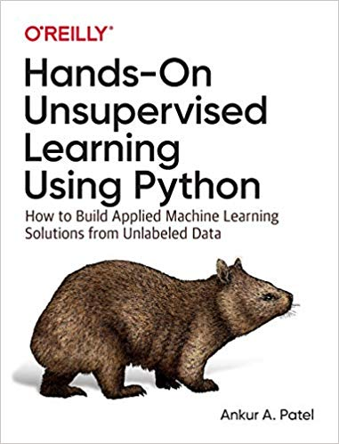
Hands-On Unsupervised Learning Using Python:
How to Build Applied Machine Learning Solutions from Unlabeled Data
Ankur A. Patel
[1]credit_card_data
Credit Card Fraud Detection | Kaggle
信用卡客戶違約預測
預測信用卡客戶下個月是否違約還款
[02_end_to_end_machine_learning_project.ipynb
04_anomaly_detection.ipynb]
[2]lending_club_data
Lending Club貸款資料分析
[06_group_segmentation.ipynb
09_semisupervised.ipynb]
[3]fashion_mnist_data
[4]mnist_data
https://github.com/aapatel09/handson-unsupervised-learning

Slide 3
Lending Club貸款資料分析
Lending Club 創立於2006年，主營業務是為市場提供P2P貸款的平臺仲介服務，公司總部位於三藩市。
公司在運營初期僅提供個人貸款服務，
至2012年平臺貸款總額達10億美元規模。
2014年12月，Lending Club在紐交所上市，成為當年最大的科技股IPO。
2014年後公司開始為小企業提供商業貸款服務。
2015年全年Lending Club平臺新設貸款金額達到了83.6億美元。
2016年上半年Lending club爆出違規放貸醜聞，創始人離職，股價持續下跌，全年虧損額達1.46億美元。
2007年到2018年第二季度的資料，共有1048575條，數據來源於kaggle
https://zhuanlan.zhihu.com/p/47674468
利用python分析Lending Club貸款資料
https://zhuanlan.zhihu.com/p/48504956

Slide 4
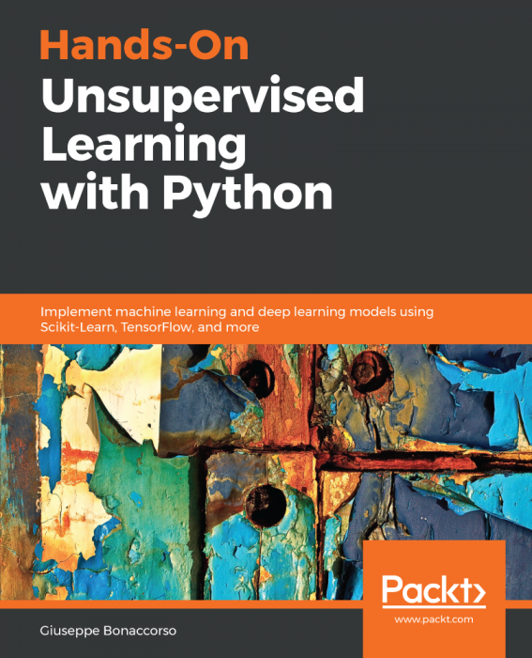
Hands-On Unsupervised Learning with Python
Giuseppe Bonaccorso
February 28, 2019
386 pages
1Getting Started with Unsupervised Learning
2Clustering Fundamentals
3Advanced Clustering
4Hierarchical Clustering in Action
5Soft Clustering and Gaussian Mixture Models
6Anomaly Detection
7Dimensionality Reduction and Component Analysis
8Unsupervised Neural Network Models
9Generative Adversarial Networks and SOMs

Slide 5
Unsupervised Learning著名演算法
Dimension reduction: linear vs nonlinear
Cluster analysis 各種叢集分析
Autoencoder: The Encoder and the Decoder
Variational Autoencoder
Unsupervised Deep Learning
Unsupervised pretraining:greedy layer-wise unsupervised pretraining(2006, Geoffrey Hinton)
Restricted Boltzmann machine (RBM)
deep belief network (DBN)
generative adversarial networks (GANs)

Slide 6
Clustering

Slide 7
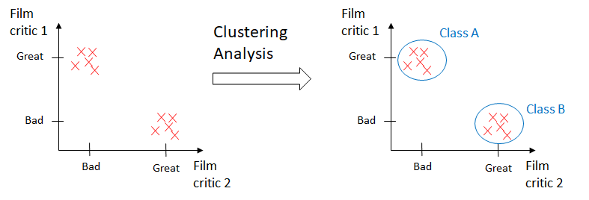

Slide 8
Cluster Analysis
Cluster: A collection of data objects
similar (or related) to one another within the same group
dissimilar (or unrelated) to the objects in other groups
Cluster analysis (or clustering, data segmentation, …)
Finding similarities between data according to the characteristics found in the data and grouping similar data objects into clusters
Unsupervised learning: no predefined classes (i.e., learning by observations vs. learning by examples: supervised)
Typical applications
As a stand-alone tool to get insight into data distribution
As a preprocessing step for other algorithms

Slide 9
Basic Cluster Analysis Methods
Cluster Analysis: Basic Concepts
Group data so that object similarity is high within clusters but low across clusters
Partitioning Methods
K-means and k-medoids algorithms and their refinements
Hierarchical Methods
Agglomerative and divisive method, Birch, Cameleon
Density-Based Methods
DBScan, Optics and DenCLu
Grid-Based Methods
STING and CLIQUE (subspace clustering)
Evaluation of Clustering
Assess clustering tendency, determine # of clusters, and measure clustering quality
9
9
Notes:
9

Slide 10
Quality: What Is Good Clustering?
A good clustering method will produce high quality clusters
high intra-class similarity: cohesive within clusters
low inter-class similarity: distinctive between clusters
The quality of a clustering method depends on
the similarity measure used by the method
its implementation, and
Its ability to discover some or all of the hidden patterns

Slide 11


Slide 12
Measure the Quality of Clustering
Dissimilarity/Similarity metric
Similarity is expressed in terms of a distance function, typically metric: d(i, j)
The definitions of distance functions are usually rather different for interval-scaled, boolean, categorical, ordinal ratio, and vector variables
Weights should be associated with different variables based on applications and data semantics
Quality of clustering:
There is usually a separate “quality” function that measures the “goodness” of a cluster.
It is hard to define “similar enough” or “good enough”
The answer is typically highly subjective

Slide 13
Considerations for Cluster Analysis
Partitioning criteria
Single level vs. hierarchical partitioning (often, multi-level hierarchical partitioning is desirable)
Separation of clusters
Exclusive (e.g., one customer belongs to only one region) vs. non-exclusive (e.g., one document may belong to more than one class)
Similarity measure
Distance-based (e.g., Euclidian, road network, vector) vs. connectivity-based (e.g., density or contiguity)
Clustering space
Full space (often when low dimensional) vs. subspaces (often in high-dimensional clustering)

Slide 14
Requirements and Challenges
Scalability
Clustering all the data instead of only on samples
Ability to deal with different types of attributes
Numerical, binary, categorical, ordinal, linked, and mixture of these
Constraint-based clustering
User may give inputs on constraints
Use domain knowledge to determine input parameters
Interpretability and usability
Others
Discovery of clusters with arbitrary shape
Ability to deal with noisy data
Incremental clustering and insensitivity to input order
High dimensionality

Slide 15
Major Clustering Approaches (I)
Partitioning approach:
Construct various partitions and then evaluate them by some criterion, e.g., minimizing the sum of square errors
Typical methods: k-means, k-medoids, CLARANS
Hierarchical approach:
Create a hierarchical decomposition of the set of data (or objects) using some criterion
Typical methods: Diana, Agnes, BIRCH, CAMELEON
Density-based approach:
Based on connectivity and density functions
Typical methods: DBSACN, OPTICS, DenClue
Grid-based approach:
based on a multiple-level granularity structure
Typical methods: STING, WaveCluster, CLIQUE

Slide 16
Major Clustering Approaches (II)
Model-based:
A model is hypothesized for each of the clusters and tries to find the best fit of that model to each other
Typical methods: EM, SOM, COBWEB
Frequent pattern-based:
Based on the analysis of frequent patterns
Typical methods: p-Cluster
User-guided or constraint-based:
Clustering by considering user-specified or application-specific constraints
Typical methods: COD (obstacles), constrained clustering
Link-based clustering:
Objects are often linked together in various ways
Massive links can be used to cluster objects: SimRank, LinkClus

Slide 17
K-Means Clustering

Slide 18
Partitioning Algorithms: Basic Concept
Partitioning method: Partitioning a database D of n objects into a set of k clusters, such that the sum of squared distances is minimized (where c_{i} is the centroid or medoid of cluster C_{i})
Given k, find a partition of k clusters that optimizes the chosen partitioning criterion
Global optimal: exhaustively enumerate all partitions
Heuristic methods: k-means and k-medoids algorithms
k-means (MacQueen’67, Lloyd’57/’82): Each cluster is represented by the center of the cluster
k-medoids or PAM (Partition around medoids) (Kaufman & Rousseeuw’87): Each cluster is represented by one of the objects in the cluster

Slide 19
K-Means Clustering
K=2
Arbitrarily partition objects into k groups
Update the cluster centroids
The initial data set
Loop if needed
Reassign objects
Partition objects into k nonempty subsets
Repeat
Compute centroid (i.e., mean point) for each partition
Assign each object to the cluster of its nearest centroid
Until no change
Update the cluster centroids
19
Notes:
19

Slide 20
The K-Means Clustering Method
Given k, the k-means algorithm is implemented in four steps:
Partition objects into k nonempty subsets
Compute seed points as the centroids of the clusters of the current partitioning (the centroid is the center, i.e., mean point, of the cluster)
Assign each object to the cluster with the nearest seed point
Go back to Step 2, stop when the assignment does not change

Slide 21
Comments on the K-Means Method
Strength: Efficient: O(tkn), where n is # objects, k is # clusters, and t is # iterations. Normally, k, t << n.
Comparing: PAM: O(k(n-k)² ), CLARA: O(ks² + k(n-k))
Comment: Often terminates at a local optimal.
Weakness
Applicable only to objects in a continuous n-dimensional space
Using the k-modes method for categorical data
In comparison, k-medoids can be applied to a wide range of data
Need to specify k, the number of clusters, in advance (there are ways to automatically determine the best k (see Hastie et al., 2009)
Sensitive to noisy data and outliers
Not suitable to discover clusters with non-convex shapes

Slide 22
Variations of the K-Means Method
Most of the variants of the k-means which differ in
Selection of the initial k means
Dissimilarity calculations
Strategies to calculate cluster means
Handling categorical data: k-modes
Replacing means of clusters with modes
Using new dissimilarity measures to deal with categorical objects
Using a frequency-based method to update modes of clusters
A mixture of categorical and numerical data: k-prototype method

Slide 23
What Is the Problem of the K-Means Method?
Sensitive to outliers !
Since an object with an extremely large value may substantially distort the distribution of the data
K-Medoids: Instead of taking the mean value of the object in a cluster as a reference point, medoids can be used, which is the most centrally located object in a cluster
10
10
9
9
8
8
7
7
6
6
5
5
4
4
3
3
2
2
1
1
0
0
1
2
3
4
5
6
7
8
9
10
0
0
1
2
3
4
5
6
7
8
9
10

Slide 24
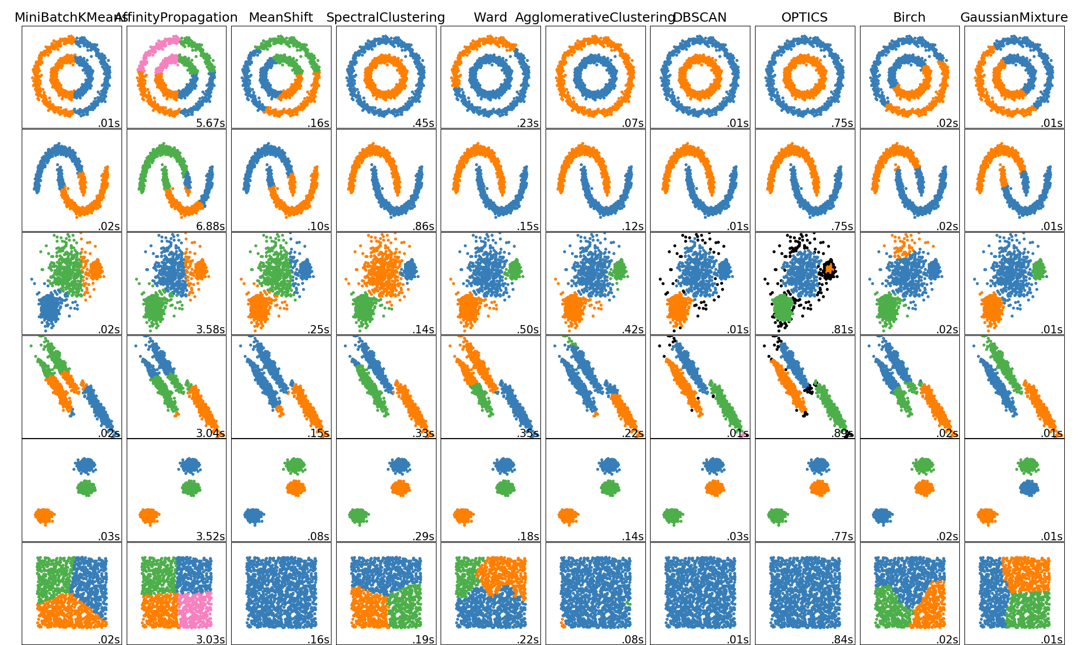
Clustering algorithms in scikit-learn

Slide 25
Dimension Reduction

Slide 26
Dimension reduction 維度縮減
linear projection | Principal component analysis (PCA) standard PCA, incremental PCA, sparse PCA, and kernel PCA
 | Singular value decomposition (SVD)
 | Random projection:using random Gaussian matrix or a random sparse matrix
nonlinear dimensionality reduction. manifold learning (流形學習) | Isomap
 | t-distributed stochastic neighbor embedding (t-SNE)
 | Dictionary learning
 | independent component analysis (ICA)
 | Latent Dirichlet allocation (LDA)
 | multidimensional scaling (MDS)
 | locally linear embedding (LLE)
 | random trees embedding

Slide 27
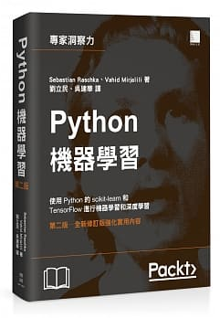
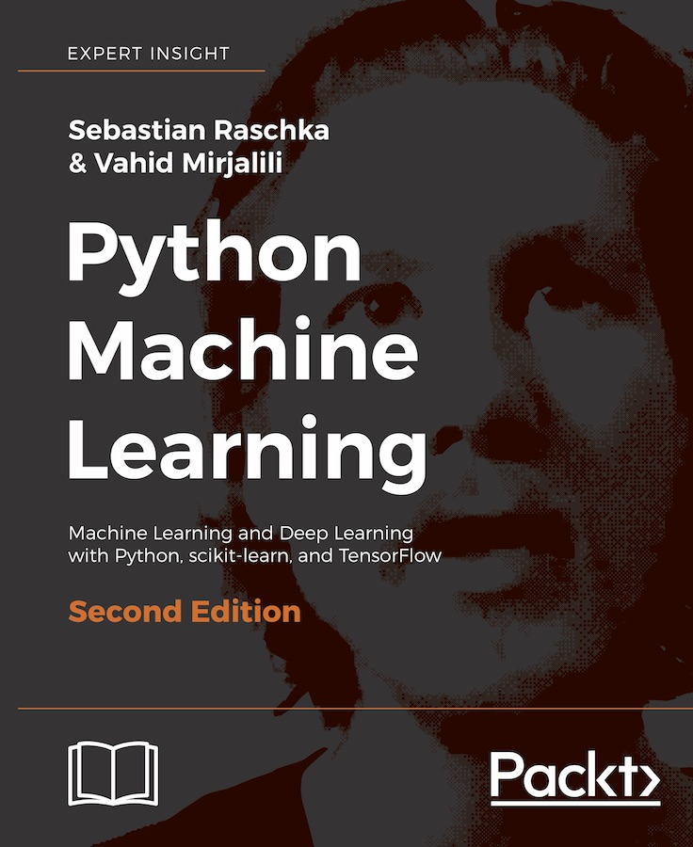
Python機器學習(第二版)
Python Machine Learning – Second Edition
作者： Sebastian Raschka, Vahid Mirjalili
譯者： 劉立民, 吳建華
博碩出版社 出版日期：2018/08/30
https://github.com/rasbt/python-machine-learning-book-2nd-edition
https://github.com/rasbt/python-machine-learning-book[第一版]

Slide 28
奇異值分解SVD

Slide 29
奇異值分解( SVD )
「對特定資料集合做拆解，以便找出相對數量少卻富含重要資訊的要素組成新資料集合，並以此來近似原先的資料集合」，達到以簡馭繁或是減少雜訊的目的( a low-dimensional representation of a high-dimensional matrix )。
方陣 U 和 V 都是實正交矩陣 (orthogonal matrix)

Slide 30
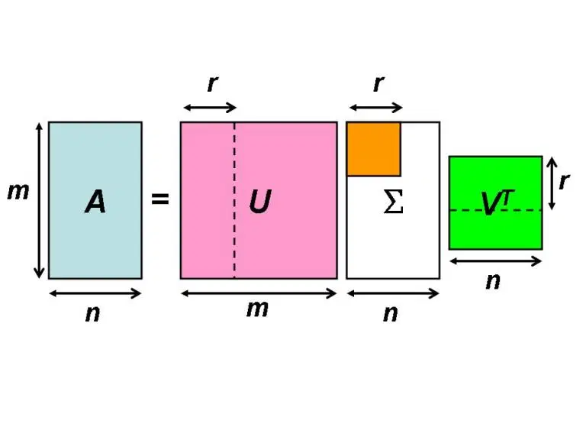
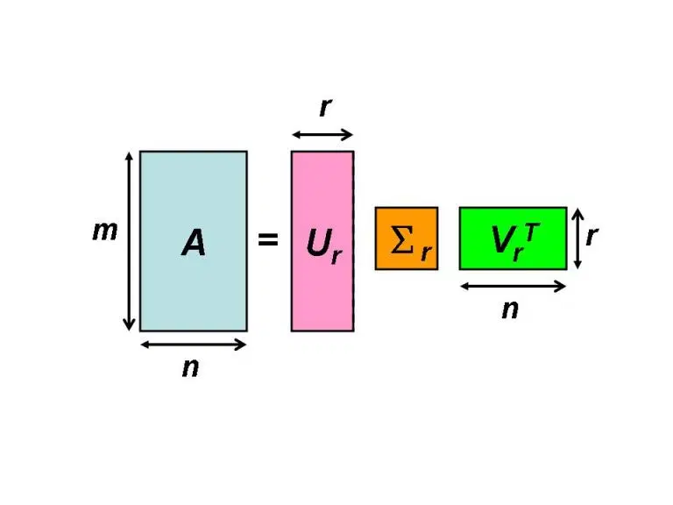

Slide 31
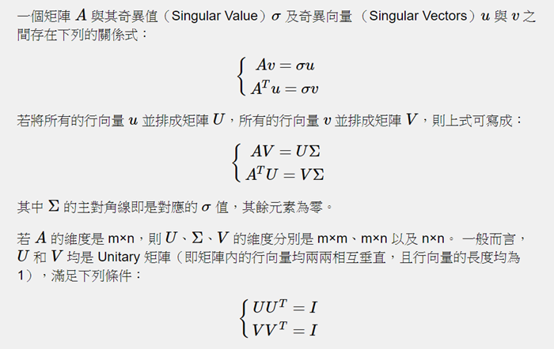
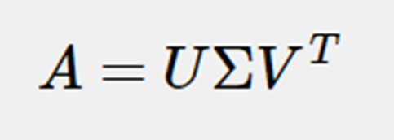
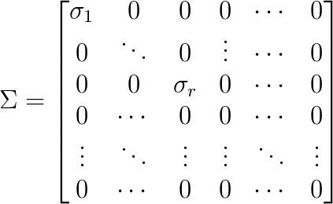
奇異值分解
Singular Value Decomposition
http://mirlab.org/jang/books/matlabProgramming4guru/06-3_linear_algebra.asp?title=6-3%20%A9%5F%B2%A7%AD%C8%BBP%A9%5F%B2%A7%A6V%B6q

Slide 32
A的奇異值分解( SVD )

Slide 33
from numpy import *
A=mat([[1,0,1],[0,1,0]])
from numpy import linalg as la
U,sigma,VT=la.svd(A)

Slide 34
將奇異值在矩陣 A從大到小的順序排列 ，然後截取其中的前百分之 多少作方整 體的一小近似 。
在很多情況下，前10%的奇異值就占了所有奇異值之和的 90% 以上
所以一般可用前 K小奇異值和對應的奇異值向量未近似描迷矩陣
K 要比M和N小得多

Slide 35
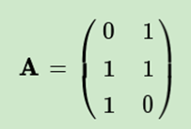
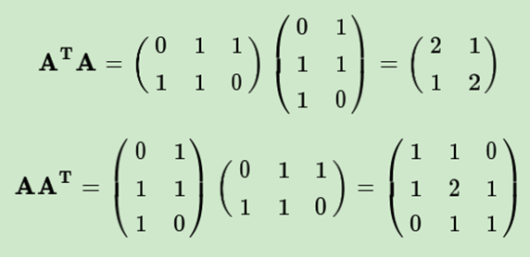
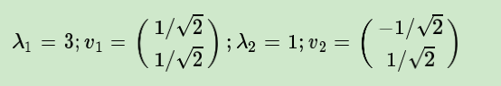
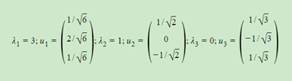
A的奇異值分解( SVD )
https://www.cnblogs.com/pinard/p/6251584.html

Slide 36
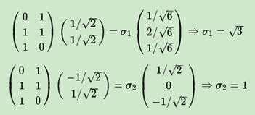

Slide 37
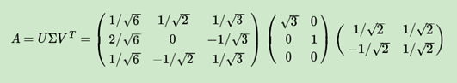

Slide 38
https://www.cnblogs.com/pinard/p/6251584.html

Slide 39
A的奇異值分解( SVD )
修正錯誤題

Slide 40
修正錯誤題
求特徵值和特徵向量
將特徵值大至小排序
特徵值
特徵向量

Slide 41
求特徵值和特徵向量
將特徵值大至小排序
特徵值
特徵向量

Slide 42
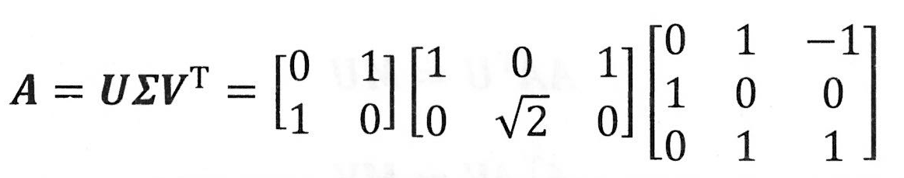
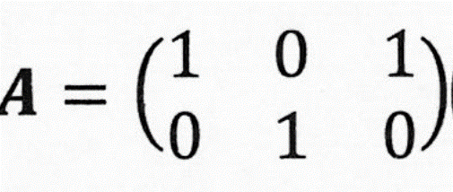
A的奇異值分解( SVD )
from numpy import *
A=mat([[1,0,1],[0,1,0]])
from numpy import linalg as la
U,sigma,VT=la.svd(A)

Slide 43
PCA

Slide 44
找出原始資料裡最主要的方面來代替原始資料，使得在損失少部分原始資訊的基礎上
極大地降低原始資料的維度
投影方向
3 樣本類別
特徵維度 2
投影至一維

Slide 45
投影方向
比較好
投影===
[1]緊湊性:樣本與投影距離近
[2]可分性:樣本投影後
仍保持分離度

Slide 46
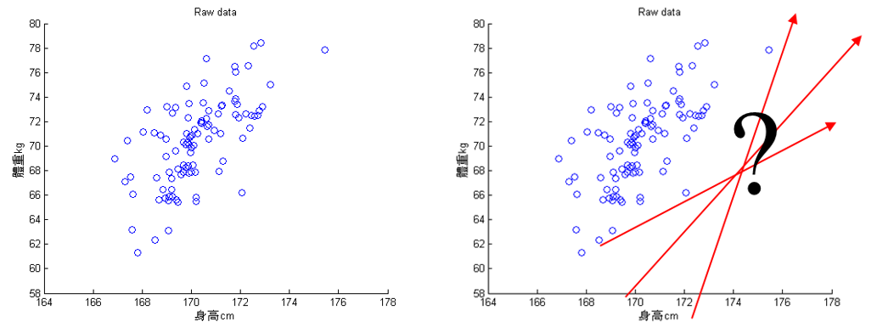
主成份分析的基本假設是希望資料可以在特徵空間找到一個投影軸(向量)投影後可以得到這組資料的最大變異量

Slide 47
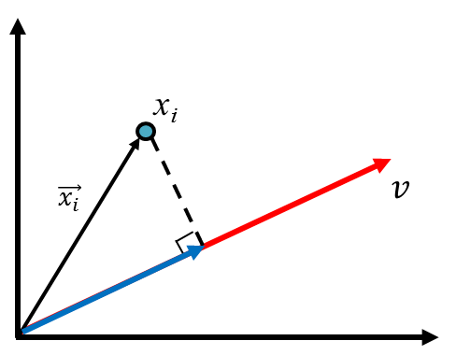
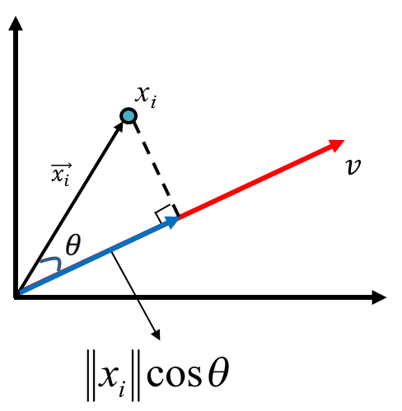
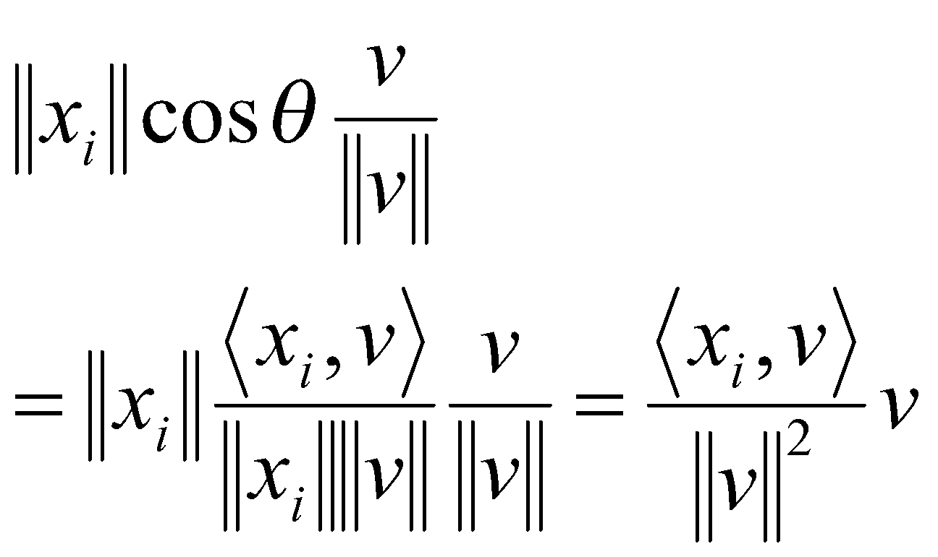
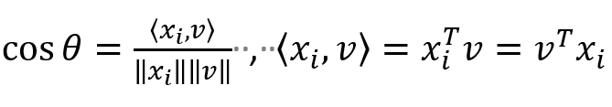
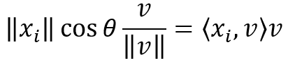
投影(projection)
如果v為單位向量(unit)

Slide 48
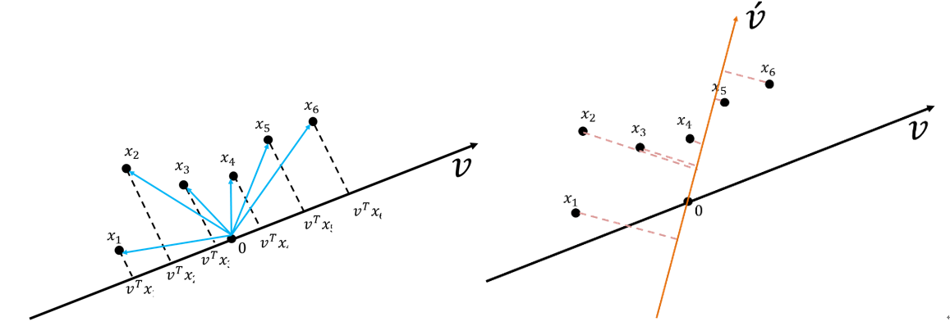
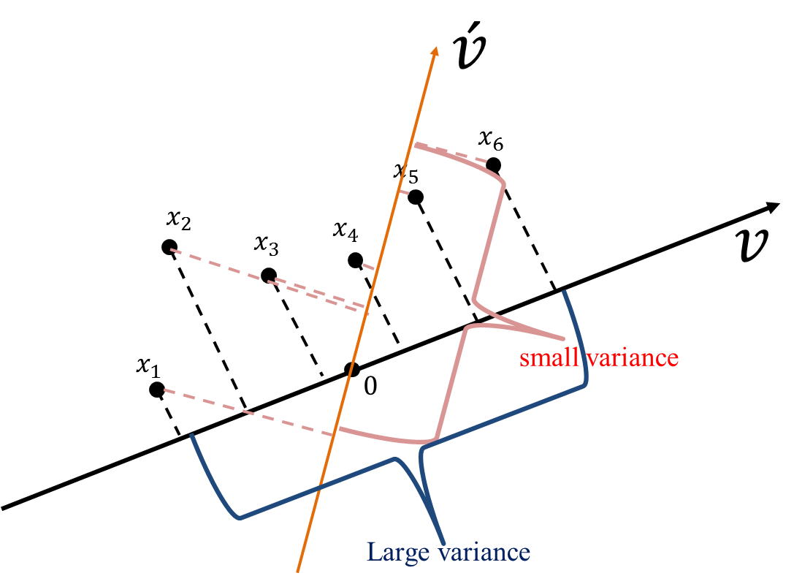
一組資料六個點的投影
變異量大
變異量小

Slide 49
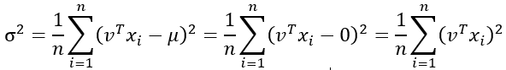
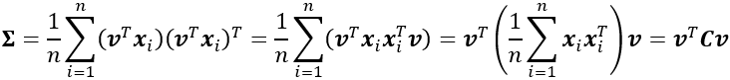
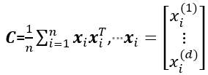
先將資料shift到0
(也就是每個變數的平均數是0)
單變量的投影後的變異數
投影後的點
多變量使用矩陣表達
C為共變異數矩陣
(covariance matrix)

Slide 50
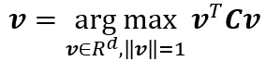
主成份分析
找投影向量讓投影後的資料變異量最大
(最佳化問題):
投影後的變異數
限制式
Lagrange
限制式

Slide 51
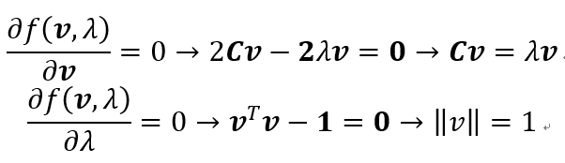
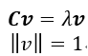
C為共變異數矩陣
(covariance matrix)
解C (共變異數矩陣)的特徵值(eigenvalue, λ )和特徵向量(eigenvector, v)

Slide 52
解出來的eigenvalue就是變異量(variance)，eigenvector就是讓資料投影下去會有最大變異量的投影軸。
https://medium.com/@chih.sheng.huang821/%E6%A9%9F%E5%99%A8-%E7%B5%B1%E8%A8%88%E5%AD%B8%E7%BF%92-%E4%B8%BB%E6%88%90%E5%88%86%E5%88%86%E6%9E%90-principle-component-analysis-pca-58229cd26e71

Slide 53
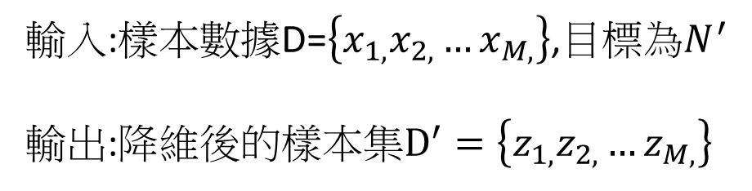
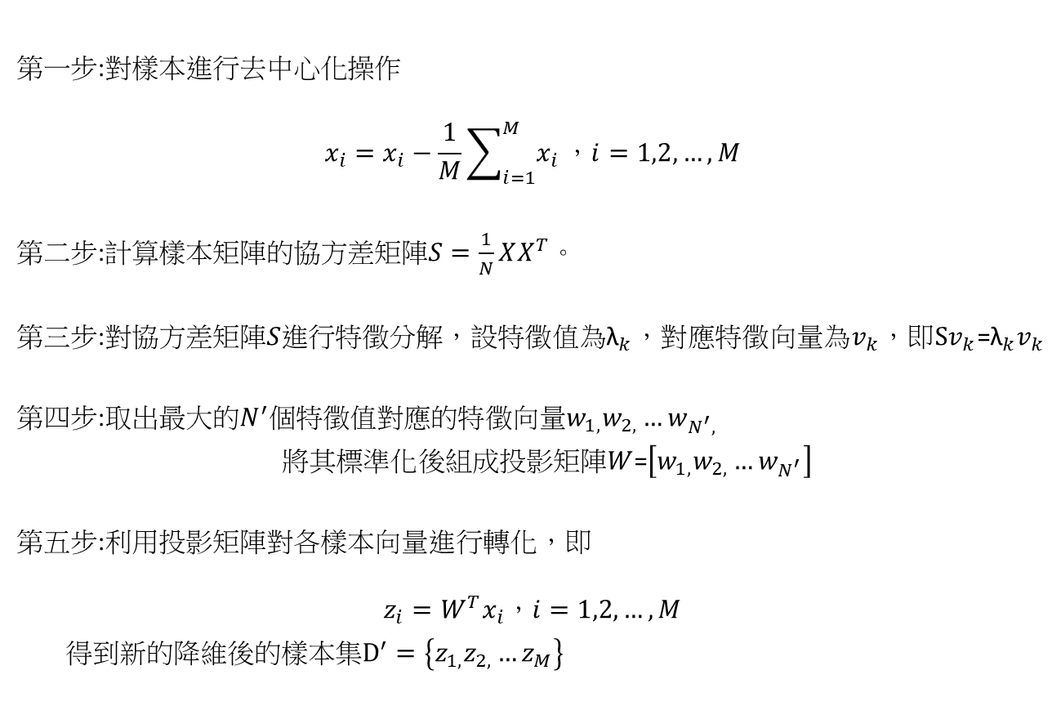
輸入:樣本數據D=$\left\{x_{1,}x_{2,}…x_{M,}\right\}$,目標為$N^{′}$
輸出:降維後的樣本集$D^{′}=\left\{z_{1,}z_{2,}…z_{M,}\right\}$
步驟
第一步:對樣本進行去中心化操作
$$x_{i}=x_{i}−\frac{1}{M}\sum_{i=1}^{M}{x_{i}}，i=1,2,…,M$$
第二步:計算樣本矩陣的協方差矩陣$S=\frac{1}{N}XX^{T}$。
第三步:對協方差矩陣$S$進行特徵分解，設特徵值為${\text{λ}}_{k}，$對應特徵向量為$v_{k}$，即$Sv_{k}$=${{\text{λ}}_{k}v}_{k}$
第四步:取出最大的$N^{′}$個特徵值對應的特徵向量$w_{1,}w_{2,}…w_{N^{′},}$
$將其標準化$後組成投影矩陣$W$=$\left[w_{1,}w_{2,}…w_{N^{′}}\right]$
第五步:利用投影矩陣對各樣本向量進行轉化，即
$$z_{i}=W^{T}x_{i}，i=1,2,…,M$$
得到新的降維後的樣本集$D^{′}=\left\{z_{1,}z_{2,}…z_{M}\right\}$

Slide 54
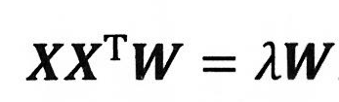
Projection:Linear Vs Nonlinear
eigenvalue
W ==投影矩陣
Nonlinear
引入kernel function核函數
核主成分分析
Kernelized PCA, KPCA

Slide 55
Ch5.Compressing Data via Dimensionality Reduction
Unsupervised dimensionality reduction via principal component analysis
Supervised data compression via linear discriminant analysis
Using kernel principal component analysis for nonlinear mappings
Python機器學習(第二版)
Python Machine Learning – Second Edition
作者： Sebastian Raschka, Vahid Mirjalili
譯者： 劉立民, 吳建華
博碩出版社 出版日期：2018/08/30
https://github.com/rasbt/python-machine-learning-book-2nd-edition
https://github.com/rasbt/python-machine-learning-book[第一版]

Slide 56
1. Standardize the d-dimensional dataset.
2. Construct the covariance matrix.
3. Decompose the covariance matrix into its eigenvectors and eigenvalues.
4. Sort the eigenvalues by decreasing order to rank the corresponding eigenvectors.
5. Select k eigenvectors which correspond to the k largest eigenvalues, where k is the dimensionality of the new feature subspace
6. Construct a projection matrix W from the "top" k eigenvectors.
7. Transform the d-dimensional input dataset X using the projection matrix W to obtain the new k-dimensional feature subspace.

Slide 57
import pandas as pd
from sklearn.model_selection import train_test_split
from sklearn.preprocessing import StandardScaler
import numpy as np
import matplotlib.pyplot as plt
from sklearn.decomposition import PCA
from matplotlib.colors import ListedColormap
from sklearn.linear_model import LogisticRegression
from sklearn.discriminant_analysis import LinearDiscriminantAnalysis as LDA
from scipy.spatial.distance import pdist, squareform
from scipy import exp
from scipy.linalg import eigh
from sklearn.datasets import make_moons
from sklearn.datasets import make_circles
from sklearn.decomposition import KernelPCA
https://github.com/PacktPublishing/Python-Machine-Learning-Second-Edition/blob/master/Chapter05/ch05.py

Slide 58
!wget https://raw.githubusercontent.com/rasbt/python-machine-learning-book-2nd-edition/master/code/ch05/wine.data
df_wine = pd.read_csv('wine.data', header=None)
df_wine.columns = ['Class label', 'Alcohol', 'Malic acid', 'Ash',
'Alcalinity of ash', 'Magnesium', 'Total phenols',
'Flavanoids', 'Nonflavanoid phenols', 'Proanthocyanins',
'Color intensity', 'Hue',
'OD280/OD315 of diluted wines', 'Proline']
df_wine.head()

Slide 59
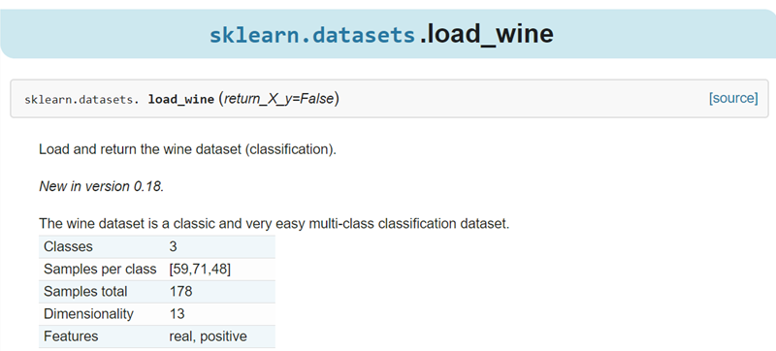
葡萄酒

Slide 60
X, y = df_wine.iloc[:, 1:].values, df_wine.iloc[:, 0].values
X_train, X_test, y_train, y_test = train_test_split(X, y, test_size=0.3, stratify=y, random_state=0)
把它標準化:standardize it to unit variance
去均值和方差歸一化。
且是針對每一個特徵維度來做的，
而不是針對樣本
sc = StandardScaler()
X_train_std = sc.fit_transform(X_train)
X_test_std = sc.transform(X_test)

Slide 61
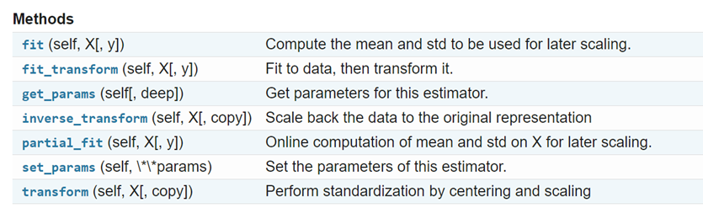
https://scikit-learn.org/stable/modules/generated/sklearn.preprocessing.StandardScaler.html

Slide 62
Construct the covariance matrix.
cov_mat = np.cov(X_train_std.T)
eigen_vals, eigen_vecs = np.linalg.eig(cov_mat)
print('\nEigenvalues \n%s' % eigen_vals)

Slide 63
tot = sum(eigen_vals)
var_exp = [(i / tot) for i in sorted(eigen_vals, reverse=True)]
cum_var_exp = np.cumsum(var_exp)
plt.bar(range(1, 14), var_exp, alpha=0.5, align='center',
label='individual explained variance')
plt.step(range(1, 14), cum_var_exp, where='mid',
label='cumulative explained variance')
plt.ylabel('Explained variance ratio')
plt.xlabel('Principal component index')
plt.legend(loc='best')
plt.tight_layout()
plt.show()

Slide 64
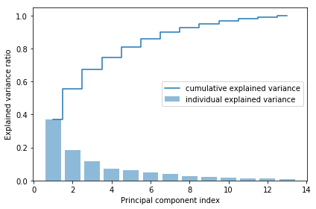

Slide 65
# Make a list of (eigenvalue, eigenvector) tuples
eigen_pairs = [(np.abs(eigen_vals[i]), eigen_vecs[:, i])
for i in range(len(eigen_vals))]
# Sort the (eigenvalue, eigenvector) tuples from high to low
eigen_pairs.sort(key=lambda k: k[0], reverse=True)
收集最大的那兩個組成W
w = np.hstack((eigen_pairs[0][1][:, np.newaxis],
eigen_pairs[1][1][:, np.newaxis]))
print('Matrix W:\n', w)

Slide 66
Matrix W:
[[-0.13724218 0.50303478]
[ 0.24724326 0.16487119]
[-0.02545159 0.24456476]
[ 0.20694508 -0.11352904]
[-0.15436582 0.28974518]
[-0.39376952 0.05080104]
[-0.41735106 -0.02287338]
[ 0.30572896 0.09048885]
[-0.30668347 0.00835233]
[ 0.07554066 0.54977581]
[-0.32613263 -0.20716433]
[-0.36861022 -0.24902536]
[-0.29669651 0.38022942]]

Slide 67
X_train_pca = X_train_std.dot(w)
colors = ['r', 'b', 'g']
markers = ['s', 'x', 'o']
for l, c, m in zip(np.unique(y_train), colors, markers):
plt.scatter(X_train_pca[y_train == l, 0],
X_train_pca[y_train == l, 1],
c=c, label=l, marker=m)
plt.xlabel('PC 1')
plt.ylabel('PC 2')
plt.legend(loc='lower left')
plt.tight_layout()
# plt.savefig('images/05_03.png', dpi=300)
plt.show()

Slide 68
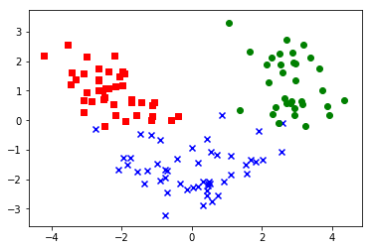

Slide 69
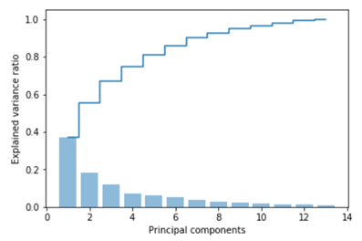
Principal component analysis @scikit-learn
from sklearn.decomposition import PCA
pca = PCA()
X_train_pca = pca.fit_transform(X_train_std)
pca.explained_variance_ratio_
plt.bar(range(1, 14), pca.explained_variance_ratio_, alpha=0.5, align='center')
plt.step(range(1, 14), np.cumsum(pca.explained_variance_ratio_), where='mid')
plt.ylabel('Explained variance ratio')
plt.xlabel('Principal components')
plt.show()

Slide 70
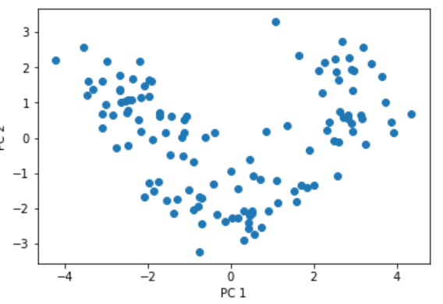
Principal component analysis @scikit-learn
pca = PCA(n_components=2)
X_train_pca = pca.fit_transform(X_train_std)
X_test_pca = pca.transform(X_test_std)
plt.scatter(X_train_pca[:, 0], X_train_pca[:, 1])
plt.xlabel('PC 1')
plt.ylabel('PC 2')
plt.show()

Slide 71
程式範例及公式推導https://ithelp.ithome.com.tw/articles/10211877
https://docs.scipy.org/doc/numpy/reference/generated/numpy.hstack.html
https://hadrienj.github.io/posts/Deep-Learning-Book-Series-2.12-Example-Principal-Components-Analysis/
StatQuest: Principal Component Analysis (PCA), Step-by-Step
https://www.youtube.com/watch?v=FgakZw6K1QQ

